Slide 1
Professional Skills Course
Instructor:
Eric White
Taos Mountain
November 2015

Slide 2
Introductions
Name.
Technology Experience.
What do you want to do?
What is blocking you from doing it?

Slide 3
Overview
PMI – www.PMI.org (Project Management Institute)
Scrum – www.scrumalliance.org (Agile)
Six Sigma – www.6sigma.us
ITIL – www.itil-officialsite.com/ (Information Technology Infrastructure Library)

Slide 4
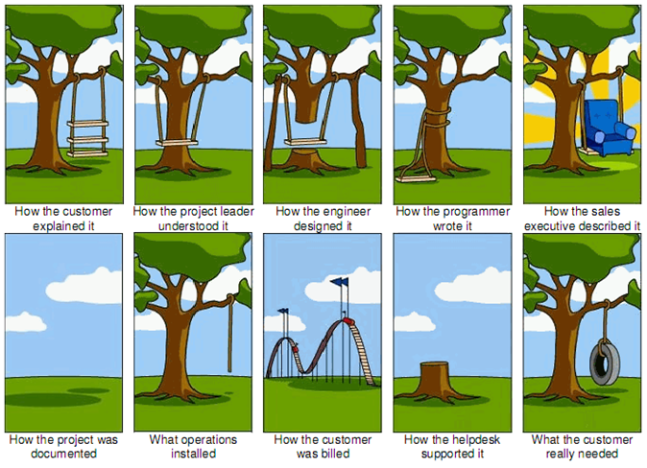
Why do we need Project Managers

Slide 5
DITL – Project Manager
What does the Day In The Life of a project manager look like?
  COMMUNICATE!!! with the team and stakeholders of the project
  Collect requirements to define the project deliverable and scope
  Manage stakeholder requirements, expectations, and scope
  Flesh out project risks, opportunities, constraints, assumptions
  Manage budget and schedule
Notes:
Collecting requirements may seem like an easy task, but it isn’t
Most times, people’s idea of what they want to have, or can really describe what they want
Sometimes it comes in layers – and in interations – how many times have you thought you wanted one thing, but it just wasn’t right for you
In the case of being a student, you will get a roster and rubric from a teacher who gives you a hopefully clear idea of what you need to do to get a good grade on a paper, homework or test. Oh, if it were only that simple with projects!
COMMUNICATE!!! with the team and stakeholders of the project
Collect requirements to define the project deliverable and scope
Manage stakeholder requirements and scope
Flesh out project risks, opportunities, constraints, assumptions
Manage budget and schedule

Slide 6
What is a project?
A temporary endeavor
  Beginning
  End
Creates a unique
  Product
  Service
  Result

Slide 7
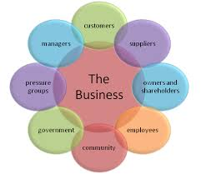
Who are stakeholders?
Stakeholders are those who have an interest or concern in the business

Slide 8
Concepts
Project Life-Cycle
  Multi-Phase process
  Assess, Plan, Develop, Deploy, Manage
  Feasibility, planning, design, production, turnover, startup
Examples – Systems Development Life Cycle (SDLC), Waterfall, Agile

Slide 9
Project Constraints
Something that will put a restriction on your project
Deal with project constraints
  Scope: What are we going to deliver?
  Cost: How much money, people, other resources?
  Time: How much time do we have?

Slide 10

Requirement Cycles
No matter what type of methodology you use:
Gather
Document
Process & Feedback
Filter & Decompose
Take big ideas and break them down into smaller parts
Gather
requirements
Document
Process
& Feedback

Slide 11
Concepts
Objectives
  Contained in Charter/Statement of Work (SOW)
  Must be complete for Project to be complete
  Terminate Project if Objectives cannot be met
  Project Manager responsible for accomplishing

Slide 12
Class Exercise
5 - 10 Minutes
Define
  Objectives
  Stakeholders
  Constraints
Present
  2-3 minute overview

Slide 13
Requirements – Scope
Defining the Project
Collecting requirements from whom?
  Define who are receivers, givers, decision-makers
Questions:
  What is the purpose of the project?
  What is the vision – what will finished product(s) look like?
  Who is it for – customers, “stakeholders”?
Notes:
layers – and in interations – how many times have you thought you wanted one thing, but it just wasn’t right for you
In the case of being a student, you will get a roster and rubric from a teacher who gives you a hopefully clear idea of what you need to do to get a good grade on a paper, homework or test. Oh, if it were only that simple

Slide 14

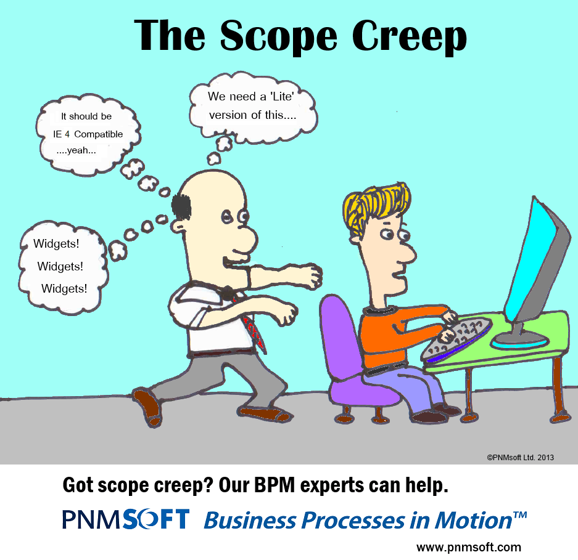
Scope
Types:
  Project Scope: (HOW) work that needs to be accomplished to deliver a product service, or result
  Product: (WHAT) Features and functions that characterize a product, service, or result

Slide 15
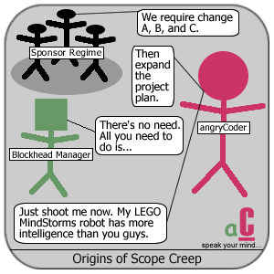
What “scope creep” is
Why is it important to keep scope creep from happening?

Slide 16
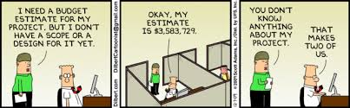
Cost - Budget
If you don’t understand scope or design, you cannot make accurate budget estimates

Slide 17
Scope Definition
Scope statement must initially contain clear descriptions of:
  Goal: the overall purpose of the project
  Objectives: what the project is aiming to achieve
  Deliverables: what products or services be produced to achieve the objectives
Then, defines what work will be done to achieve the objectives and deliverables
Notes:
Provides a basis for defining work to be done and resources needed Improved accuracy of project estimates Enables review, verification and approval of scope by stakeholders

Slide 18
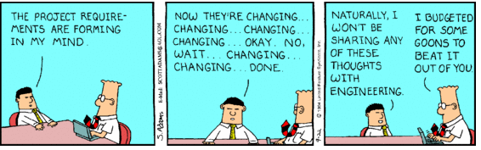
Manage Requirements
Manage stakeholder requirements and scope
  Constant struggle between pleasing your customers and keeping your baseline

Slide 19
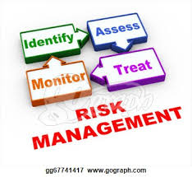
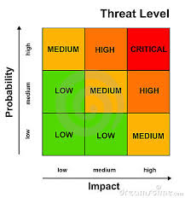
Risks & Opportunities
Constant cycle to track & mitigate Risks
Tools to assess Risks

Slide 20
Concepts - Agile
“We are uncovering better ways of developing software by doing it and helping others do it. Through this work we have come to value:
Individuals and interactions over processes and tools
Working software over comprehensive documentation
Customer collaboration over contract negotiation
Responding to change over following a plan
That is, while there is value in the items on the right,
we value the items on the left more.”
Manifesto for Agile Software Development, www.agilemanifesto.org

Slide 21
Templates
Project Charter
Meetings
  Agenda
  Minutes
  Action Items
Status Reports
Issue Log
Responsibility Matrix

Slide 22
Conclusion
Any Questions???

Slide 23
Conclusion
Thank You!!!

